Slide 1


Team1
Carriage Github
Spring 2021
Vihan Parmar
Mady Dembele
Roneil Boodram
Lang Gong
George Lopez
Jevon Cowell
Tianqi Han
Maisha Masnoon

Slide 2
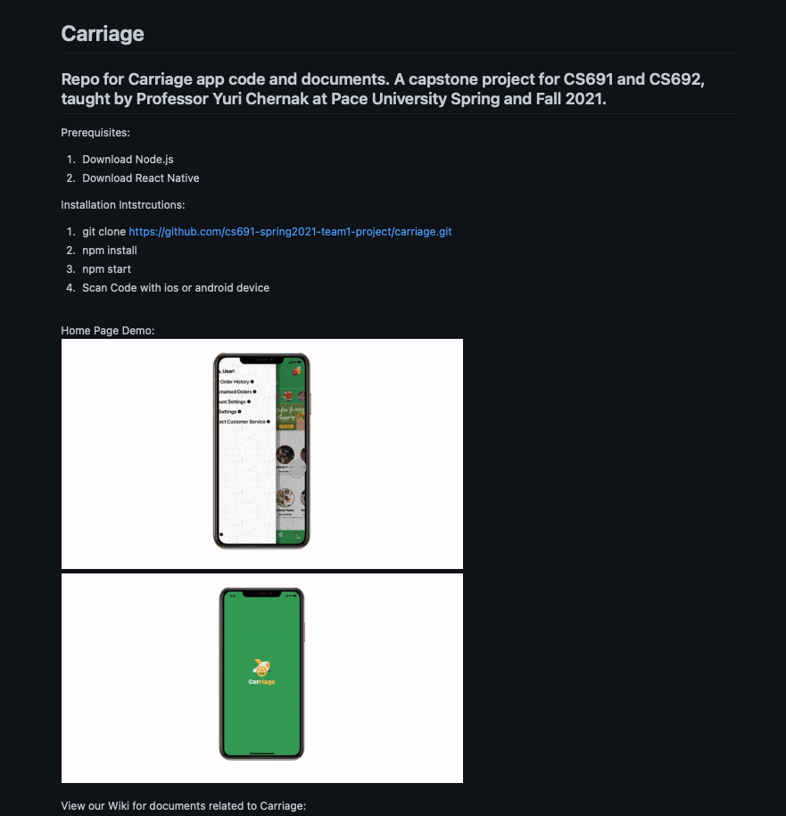

Slide 3
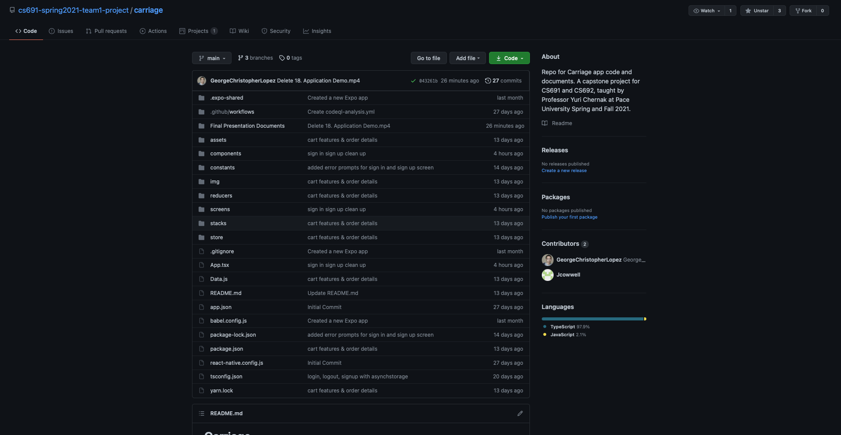

Slide 4
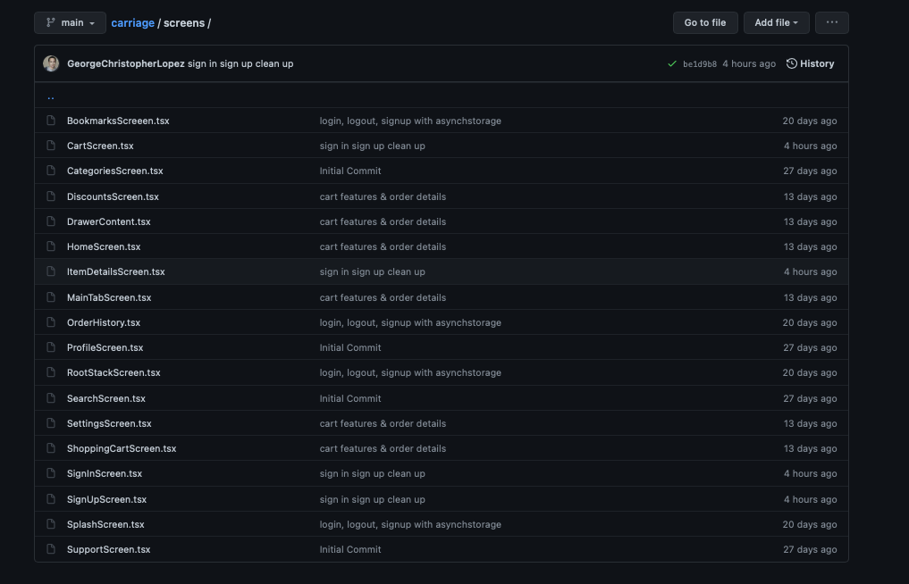

Slide 5
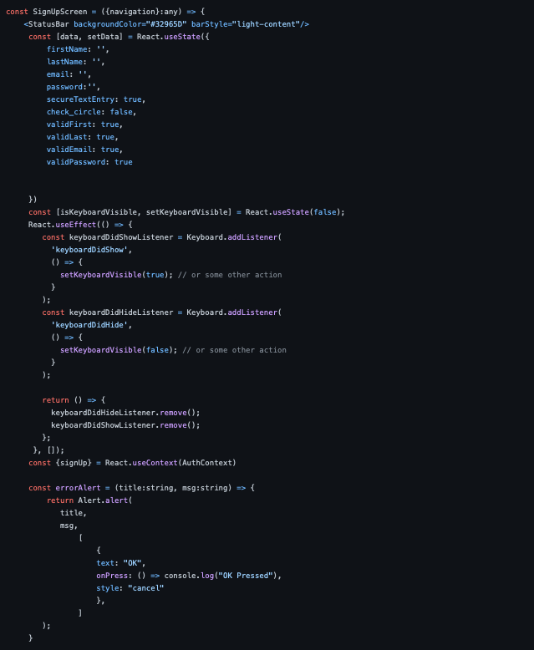
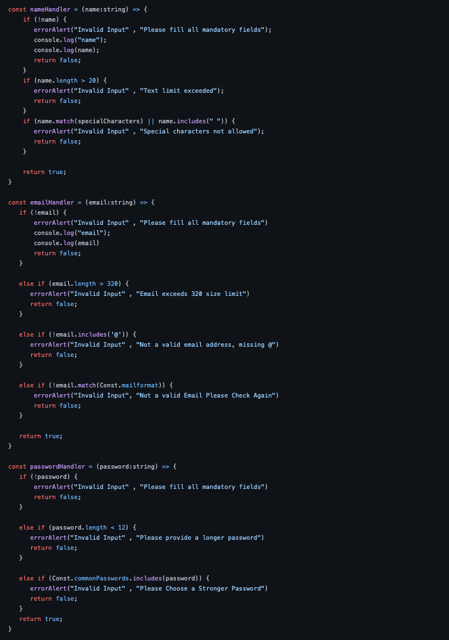

Slide 6
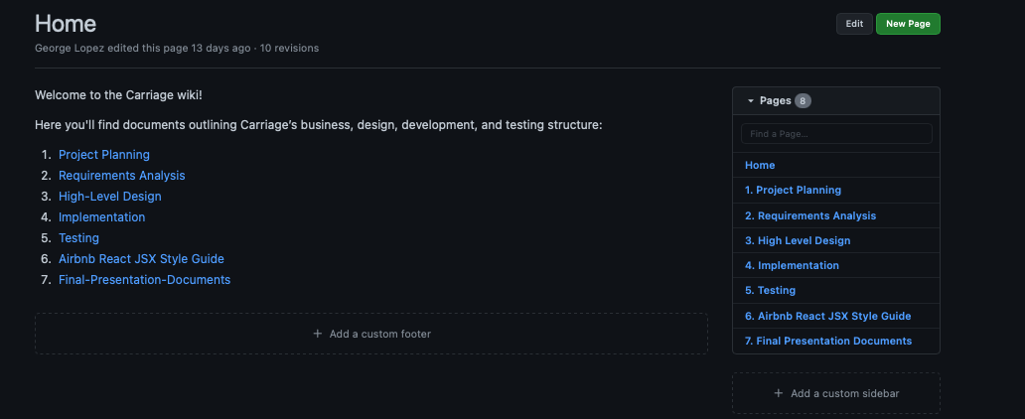
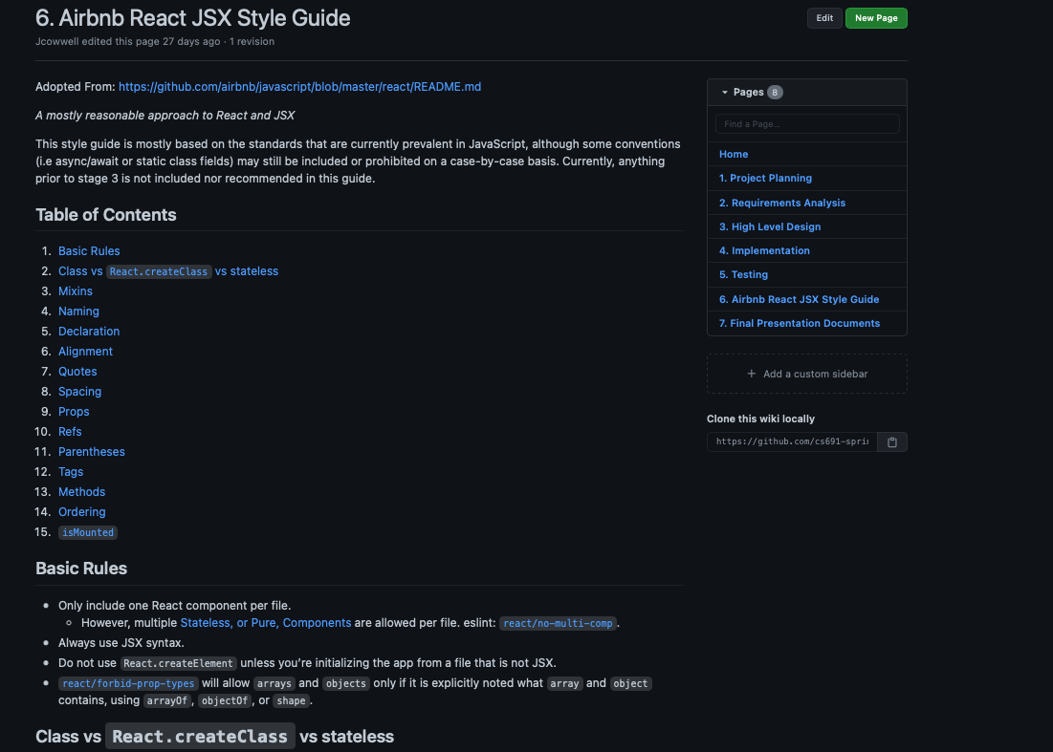
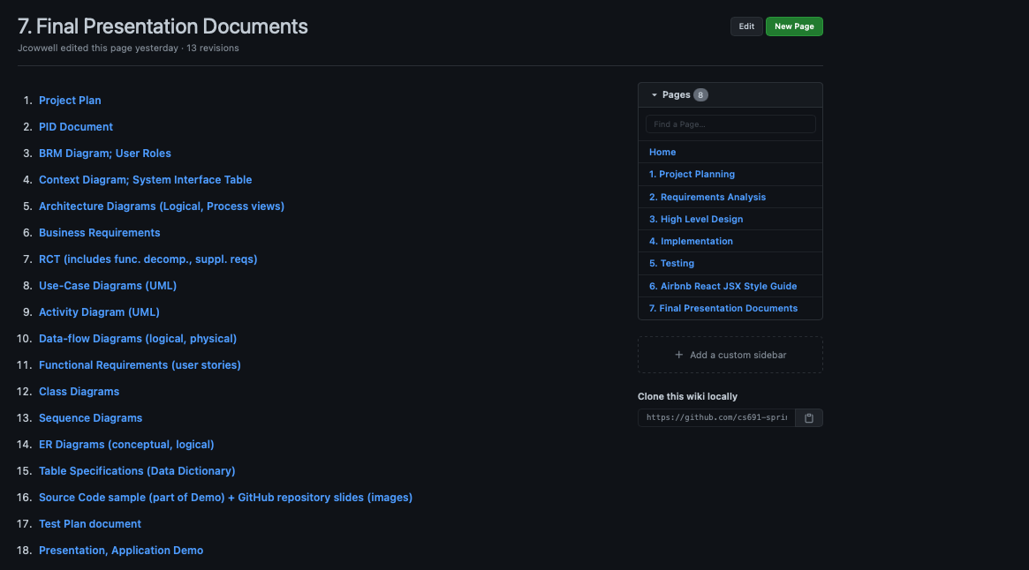

Slide 7
Thank you!

